Slide 1



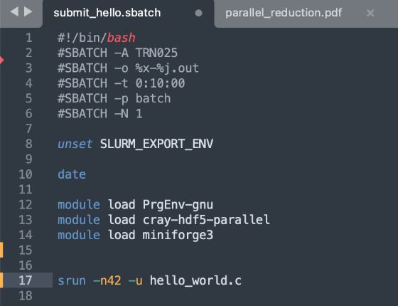
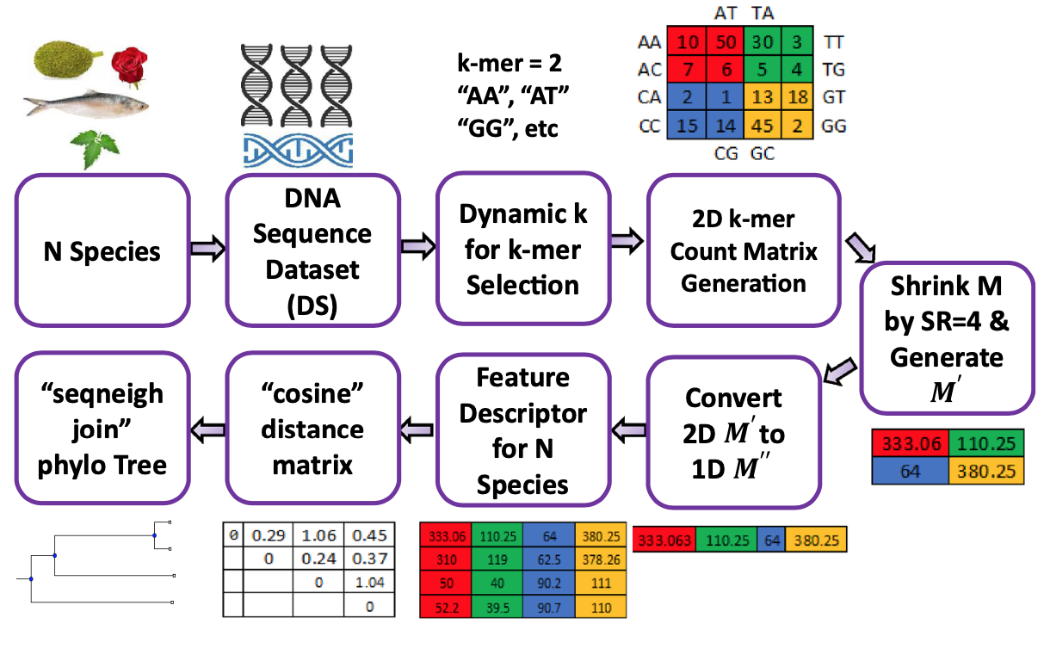


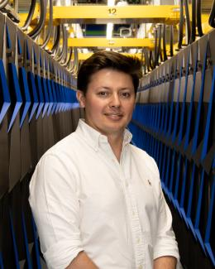
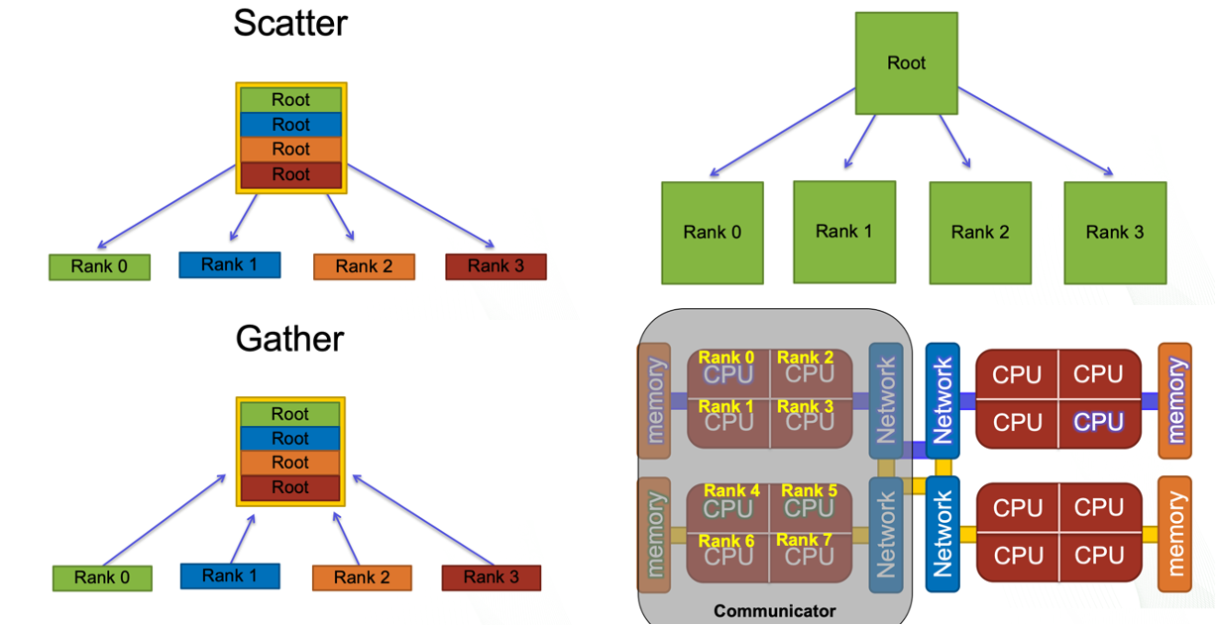
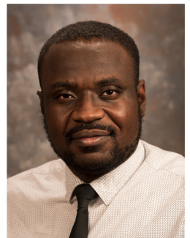
Curriculum enhancement of the Parallel Computing course at Jackson State University.
SGX3 award # 2231406
Revised Course Description
Sample HPC/Gateways Exercise
Gateway Community Mentor Syllabus Suggestions
This course (CSC 425) is for junior to senior Computer Science (CS) and Computer Engineering (CE) students. Based on the curriculum, all students should have already finished programming languages, operating systems, computer architectures, and data structure courses to develop sequential programs. The course, will focus on implementing parallel algorithms. The topics of the course include programming languages with libraries such as OpenMP, MPI, and OpenACC.
The programming models consist of several subareas:
Data parallelism
Task parallelism
Multithreaded programming
Shared memory model
Message-passing model (MPI)
Genomics Big Data Problem:
The simple DNA problem:
DNA sequences are represented as character strings, with each character representing a nucleotide type. The DNA sequence alignment problem, or pattern searching problem, identifies coincidences of nucleotide strings in a long DNA sequence. Multiple pattern matching is a complex problem in a DNA sequence.
Our assignment addresses this by
finding matches in a random main DNA sequence with multiple nucleotide patterns,
Use a brute-force algorithm that checks each pattern at every possible position in the DNA sequence, offering parallelization opportunities like in Figure 2.
Several changes were suggested, including:
Add basic Linux and command line content to introduce HPC clusters in the course.
Remote connection to the HPC cluster using SSH.
Sending jobs to supercomputer using SLURM.
VIM usage for text edition.
Move from CUDA to OpenACC to be able to use any kind of GPU accelerator.
Use Cases
Implementation Schedule
The skills and knowledge to the DNA sequency can be utilized in developing:
plant breeders selection,
contributing to higher crop yields,
disease-resistant crops, and
diagnosing and treating diseases.
The course is expected to be offered to students next fall 2025.
Possible Expansions
Develop program that can generate patterns and locations.
References
Relevant Projects
[1]. Victor Eijkhout, The Art of High Performance Computing, 3rd edition 2022.
[2]. Machbah Uddin et al. A fast and efficient algorithm for DNA sequence similarity identification. Complex & Intelligent Systems (2023) 9:1265–1280
Implement three parallel algorithms:
Fibonacci computation Algorithms;
Principal Component Analysis (PCA) for Large Data Sets with Parallel Data Summarization;
Parallel algorithm for DNA sequence.
Authors
Resource Needs/List
Author
Photo
Sungbum Hong
Jackson State University
sungbum.hong@jsums.edu
Symmetric multiprocessing (SMP) type HPC for OpenMP,
Cluster of computers for MPI
Cluster of Computer with GPUs for OpenACC
SAMtools and HTSlib on three different types of computing facility.
OpenMP-compatible C compiler, any MPI library.
OpenACC-comparable C compiler.
Figure 2: Sample DNA sequence similarity identification model [2].
HPC/Gateways Mentor
Fernando Posada
Oak Ridge National Laboratory
posadacorref@ornl.gov
Figure 3: Frontier Supercomputer access via Pathways for Supercomputing
Resources / Science Gateways
Datasets
Github repositories
https://data.world/datasets/
Designsafe-CI - https://www.designsafe-ci.org
https://Kaggle.com
pip install genomic-benchmarks (dataset would be installed directly on the machine)
HPC/Gateways Mentor
Samuel Fagbemi
Oak Ridge National Laboratory
fagbemisa@ornl.gov
Symmetric multiprocessing (SMP) type HPC for OpenMP
Pathways For Supercomputing
ACCESS
Globus for data transfers
Figure 1: Common MPI Directives [1].
MORE INFORMATION → https://hackhpc.github.io/facultyhack-gateways24__

